Slide 1

“Data” Is a Lossy
Compression of Reality
An Exploration of Representations & Abstraction
Presented by: Mitchell Aaron Carroll
2026-03-31

Slide 2

What is this?
Notes:
Ask the audience what this is. They’ll say various answers, and you need to delve deeper.

Slide 3

Reality vs. Data
The Entity
Countless biological actions, olfactory inputs, trillions of cell interactions, temporal state, etc.
{ "type": "Dog", “breed” : “golden_retriever”, "kg": 5 }
Software doesn't interact with the dog. It interacts with the decision of what was worth measuring.

Slide 4


What is a Data Model?
Irreversible Entropy
The Semantic Bridge
Once reality is compressed into bits, the mapping is one-way. You cannot reconstruct a dog from a row in a database.
Data modeling is the process of deciding which subset of reality is Signal and which subset is Noise.
The Bottleneck: If your model discards the signal needed for a decision, that decision becomes impossible.
It is an act of "Lossy Compression" where the discarded parts are gone forever.

Slide 5






Formalizing Representation
We represent the world via a projection function mapping an infinite-dimensional reality space into a finite representation space.
(Reality)
(The Model)
Infinite entropy
Finite state vector or function
* Expert Note: Z as a function (Neural representation / INR) treats reality as behavior, not just static state.

Slide 6


The Heuristic of Loss
Infinite Reality
The world in all its complexity, nuance, and endless detail.
The Model
Useful Signal
Discarded Reality
Everything we chose to ignore to make the math work.
DATA MODELING
Modeling isn't about being "right"; it's the selective process of choosing what to throw away.
The "error" is just the shadow of the world we left behind.

Slide 7
Dimensions of Failure
10∞
The Ghost in the Machine
AI models rarely fail due to "Bad Math." They fail because the signal required to solve the problem was discarded during the compression step.
The residual error is simply the phantom of the reality you ignored.
REALITY DIMENSIONS

Slide 8
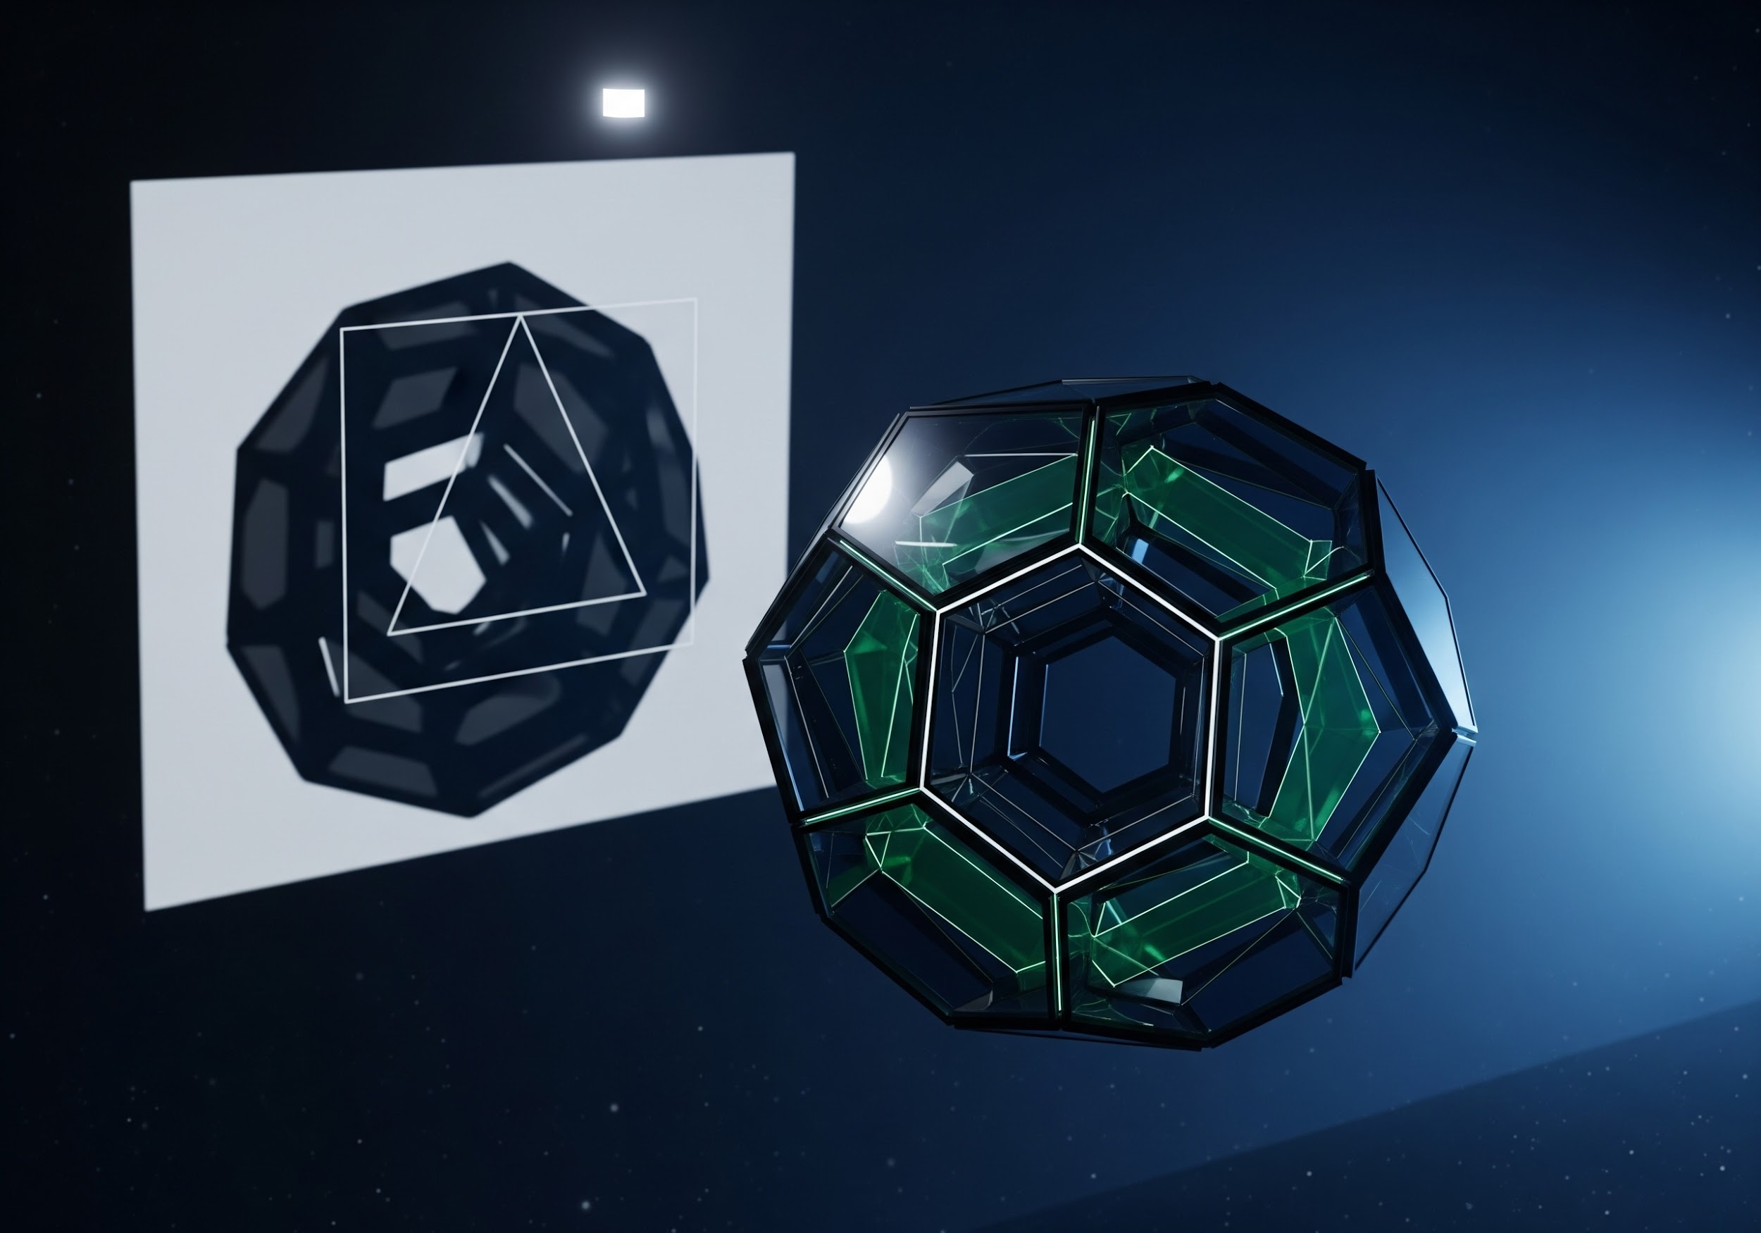
Data as Projection
The Shadow Metaphor
Think of a 3D object. A data model is a light casting a 2D shadow onto a wall.
The shadow is not the object. Depending on your model (the light's angle), you get different, incomplete truths.
EXPERT INSIGHT
Most systems optimize for the shadow, forgetting the object exists in higher dimensions.

Slide 9

The Bottleneck Curve
Proper modeling is the search for the Optimal Compression Point.

Slide 10
Where Failure Happens
Semantic Over-Compression: Modeling the "Action" but losing the "Intent." (Clicks vs. Desire).
Snapshot Fallacy: Treating a dynamic temporal reality as a static table row.
The Proxy Trap: Optimizing for a captured metric that is only weakly correlated with the discarded reality.
Latent Hallucination: When AI fills gaps in lossy data with statistical noise that "looks" like signal.

Slide 11
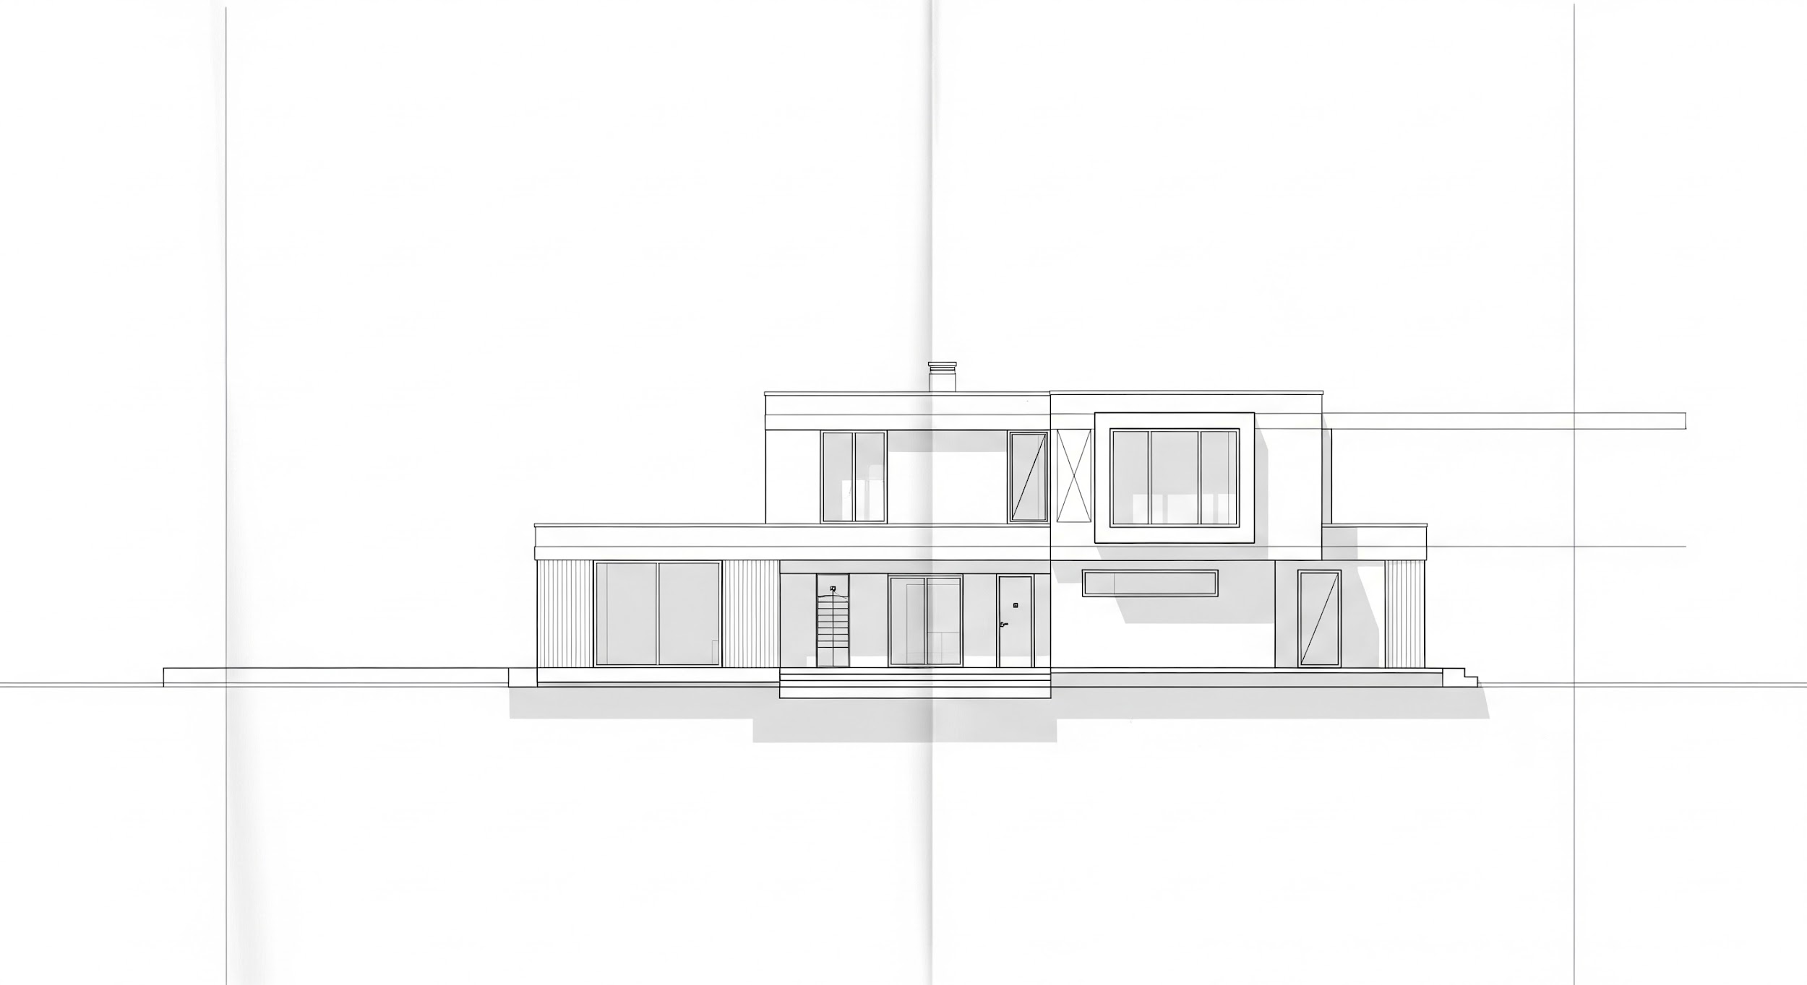


Compression in the Real World
Mastering the art of what to keep and what to discard.
Blueprints
Transit Maps
Cooking Recipes
A house is complex physical structure; a blueprint is a few lines. Yet, we can still use the blueprints to build.
The most useful maps are geographically "wrong." They distort distance to clarify the only thing that matters: the connections.
A recipe ignores the exact weight of an egg. It provides a functional approximation that ensures a successful meal every time.

Slide 12

Useful Compression
We cannot model reality fully
Every system compresses reality
Compression introduces loss
Success comes from choosing what to ignore
The question isn’t what you capture. It’s what you can afford to ignore.

Slide 13
The Latent Future
Moving from Discrete Schemas to Continuous Probabilities
The next generation of industry models won't be defined by rows and columns, but by high-dimensional Latent Embeddings that preserve the "soul" of reality through functional approximation.

Slide 14
Interactive Exercise: Encoding Reality
Setup
• Form pairs or groups of three
• Identify Speaker & Listeners
Instructions
Speaker
Think of a simple object (don't name it). Describe it for 30–60 seconds.
After:
Compare drawings with the original idea
Listeners
Draw what you think the object is based solely on the description.

Slide 15


Q&A
Choose what you throw away carefully.
Reality:
| Compression:
| Signal:

